Slide 1
Week 4
THE relational algebra Unary operations of Projection and Selection

Slide 2
Student Objectives
Upon completion of this video, you should be able to:
Write a relational algebra expression that uses SELECTION given a table and a query.
Given a table and a SELECTION relational algebra expression, show the new table that would be returned once the expression is performed on the table.
Write a relational algebra expression that uses PROJECTION given a table and a query.
Given a table and a PROJECTION relational algebra expression, show the new table that would be returned once the expression is performed on the table.
Write an expression that renames an attribute
Break an expression down so that it creates temporary tables that are used as input to the next expression

Slide 3
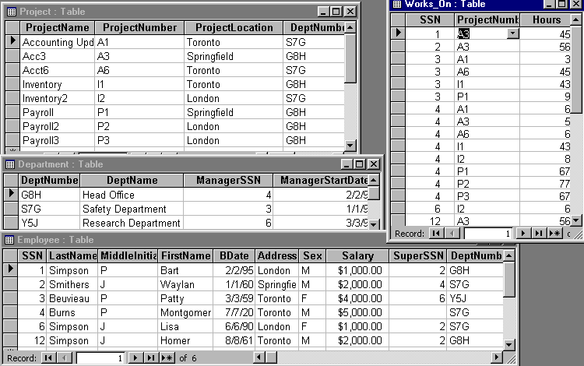
Examples of Projection & Selection
Using the following data:

Slide 4
Selection
Create a new table from a given table and in that new table return only the rows that satisfy a given condition
Symbol → σ
Example Expression:
σ _{Age > 30} (EMPLOYEE)
EMPLOYEE
ID | FirstName | LastName | Age
12 | Homer | Smith | 24
24 | Gene | Simpson | 13
45 | Walter | Reid | 45
47 | William | Reid | 87
78 | Ben | Cooker | 14
ANSWER
ID | FirstName | LastName | Age
45 | Walter | Reid | 45
47 | William | Reid | 87
Symbol for Selection
Condition that each row must satisfy to be returned in the answer
Table Name

Slide 5
QUESTION: What would be returned with the expression: σ _{Salary > 3000} (Employee)
The above rewritten as an English question would be: Find all the employee information about employees who make a salary greater than 3000. This is called a QUERY
ANSWER
SSN | LastName | MiddleInitial | FirstName | Bdate | Address | Sex | Salary | SuperSSN | DeptNum
3 | Beuvieau | P | Patty | 3/3/59 | Toronto | F | 4000 | 6 | Y5J
4 | Burns | P | Montgomery | 7/7/20 | Toronto | M | 5000 |  | S7G

Slide 6
QUESTION: What would be returned with the expression: σ _{Salary > 3000} (Employee)
The above rewritten as an English question would be: Find all the employee information about employees who make a salary greater than 3000. This is called a QUERY
ANSWER
SSN | LastName | MiddleInitial | FirstName | Bdate | Address | Sex | Salary | SuperSSN | DeptNum
3 | Beuvieau | P | Patty | 3/3/59 | Toronto | F | 4000 | 6 | Y5J
4 | Burns | P | Montgomery | 7/7/20 | Toronto | M | 5000 |  | S7G

Slide 7
PROJECTION
Create a new table from a given table and in that new table return only the COLUMNS that satisfy a given condition
Symbol → π
Example Expression:
π _{Age,LastName} (EMPLOYEE)
EMPLOYEE
ID | FirstName | LastName | Age
12 | Homer | Smith | 24
24 | Gene | Simpson | 13
45 | Walter | Reid | 45
47 | William | Reid | 87
78 | Ben | Cooker | 14
ANSWER
Age | LastName
24 | Smith
13 | Simpson
45 | Reid
87 | Reid
14 | Cooker
Symbol for Projection
The Columns (Attributes) that should be returned
Table Name

Slide 8
QUESTION: What would be returned with the expression:
π _{LastName, FirstName} (Employee)
ANSWER
LastName | FirstName
Simpson | Bart
Smithers | Waylan
Beuieau | Patty
Burns | Montgomery
Simpson | Lisa
Simpson | Homer
QUESTION: Rewrite the question above as a query (English Question):
ANSWER: Give me just the first name and last name of all the employees.

Slide 9
QUESTION: What would be returned with the expression:
π _{LastName, FirstName} (Employee)
ANSWER
LastName | FirstName
Simpson | Bart
Smithers | Waylan
Beuieau | Patty
Burns | Montgomery
Simpson | Lisa
Simpson | Homer
QUESTION: Rewrite the question above as a query (English Question):
ANSWER: Give me just the first name and last name of all the employees.

Slide 10
QUESTION: Write the expression to find all project information about projects located in Toronto or London:
σ (ProjectLocation = ‘Toronto’ or ProjectLocation = ‘London’) (Project)
QUESTION: Write the expression to find all department names:
π _{DeptName} (Department)
QUESTION: Write the expression to find the address and first name of male employees:
π _{Address,FirstName}( σ _{(Sex=‘M’)} (Employee))

Slide 11
Sequence of Operations
Building Temporary Tables
Can break a series of operation down into separate operation and temporarily rename resulting relations
Example: The following expression:
π _{LastName, Sex} (σ _{BDate > 1/1/70} (Employee))
Can be broken down into:
Temp1 ← σ _{BDate > 1/1/70} (Employee)
Temp2 ← π _{LastName, Sex} (Temp1)
Temp2
LastName | Sex
Simpson | M
Simpson | F
Temp1
SSN | LastName | MiddleInitial | FirstName | Bdate | Address | Sex | Salary | SuperSSN | DeptNum
1 | Simpson | P | Bart | 2/2/95 | London | M | 1000 | 2 | G8H
6 | Simpson | J | Lisa | 6/6/90 | London | F | 1000 | 2 | S7G

Slide 12
Renaming Attributes:
You may need to rename attributes to make the names easier to understand and occasionally you MUST rename attributes when performing union and joins.
Example:
TempTabA _{(LName, MorF)} ← π _{LastName, Sex} (Temp2)
Temp2
TempTabA
LastName | Sex
Simpson | M
Simpson | F
Lname | MorF
Simpson | M
Simpson | F

Slide 13
QUESTION: Are these the same? YES or NO?
TableA → π _{LastName, Sex} (σ _{Bdate > 1/1/70} (Employee))
TableB → σ _{Bdate > 1/1/70} (π _{LastName, Sex} (Employee))
TableA
LastName | Sex
Simpson | M
Smithers | M
Beuieau | F
Burns | M
Simpson | F
Simpson | M
LastName | Sex
Simpson | M
Simpson | F
SSN | LastName | MiddleInitial | FirstName | Bdate | Address | Sex | Salary | SuperSSN | DeptNum
1 | Simpson | P | Bart | 2/2/95 | London | M | 1000 | 2 | G8H
6 | Simpson | J | Lisa | 6/6/90 | London | F | 1000 | 2 | S7G

Slide 14
NEVER SHOW DUPLICATE ROWS IN RELATIONAL ALGEBRA
QUESTION: What would be returned with the expression: π _{MiddleInitial}(Employee)
MiddleInitial
P
J
P
P
J
J
ü
MiddleInitial
P
J

